Slide 1

Service - Support Recommendation
Team 13

Slide 2

Meet Alice A DELL customer
Age - 24
Gender - Female
Working Professional
Travelling Enthusiast
Interested in photography
Owns a Dell laptop and CPU
We have access to her browsing history

Slide 3
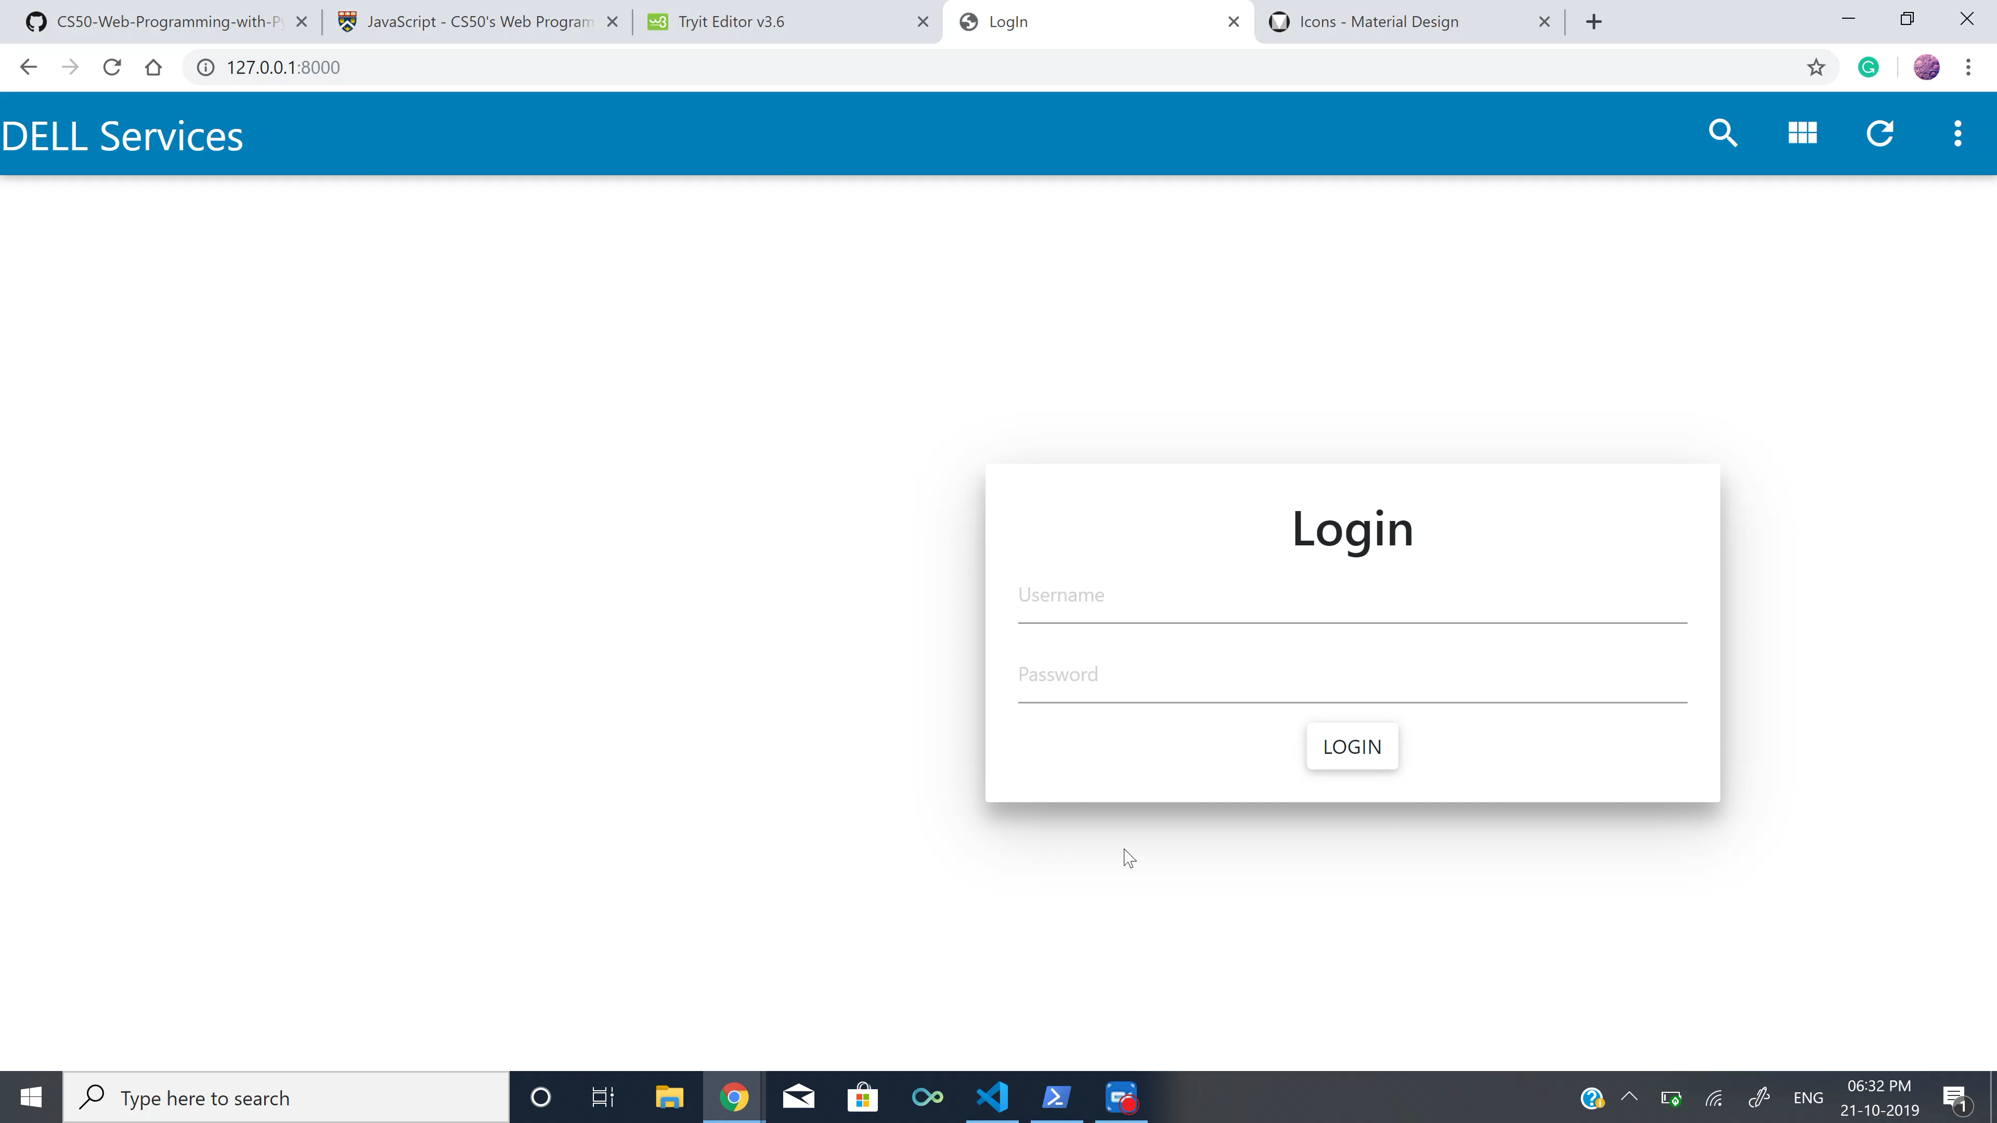
DEMO
Recommendation System

Slide 4


PhotoDirector & PowerDirector
Photo and Video editing software recommended by DELL services.
Alice purchased a video camera. So, we suggest our video editing software.
Got a new camera!? Here is a video editing software for you.

Slide 5

McAfee® Antivirus
Shields devices from threats.
Projects upto any 3 devices - PCs, Smartphones or tablets with one subscription.
Alice accessed malicious URLs , so we recommend her to subscribe to McAfee® antivirus.
We see that you have browsed through malicious websites! Here is an Antivirus to keep your device secure and protected.

Slide 6
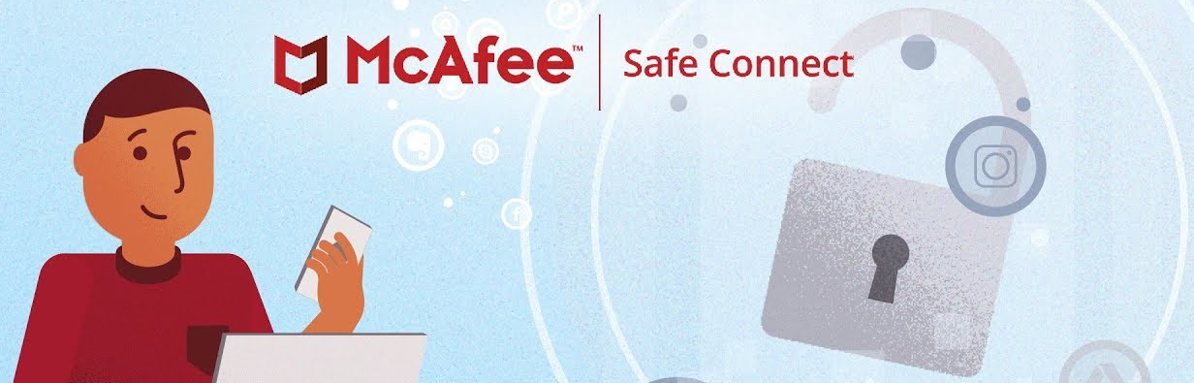
VPN Privacy
Maximises your invest. Keeps your connection safe and safe.
Alice has used many public wifis prone to hacking. So, we suggest her to use McAfee Safe Connect
Public wifi's are unsecure and usually prone to hackers! Consider using a pivate VPN to keep your data protected.

Slide 7

Premium Support Plus
Benefits of Premium Support - Accidental damage cover - Automated PC optimisation
Alice booked a flight ticket to Rome and might take her dell device with her. She better opt for dell’s premium plus service.
We see that you have made plans to travel internationally! An international warranty will keep your device protected.

Slide 8
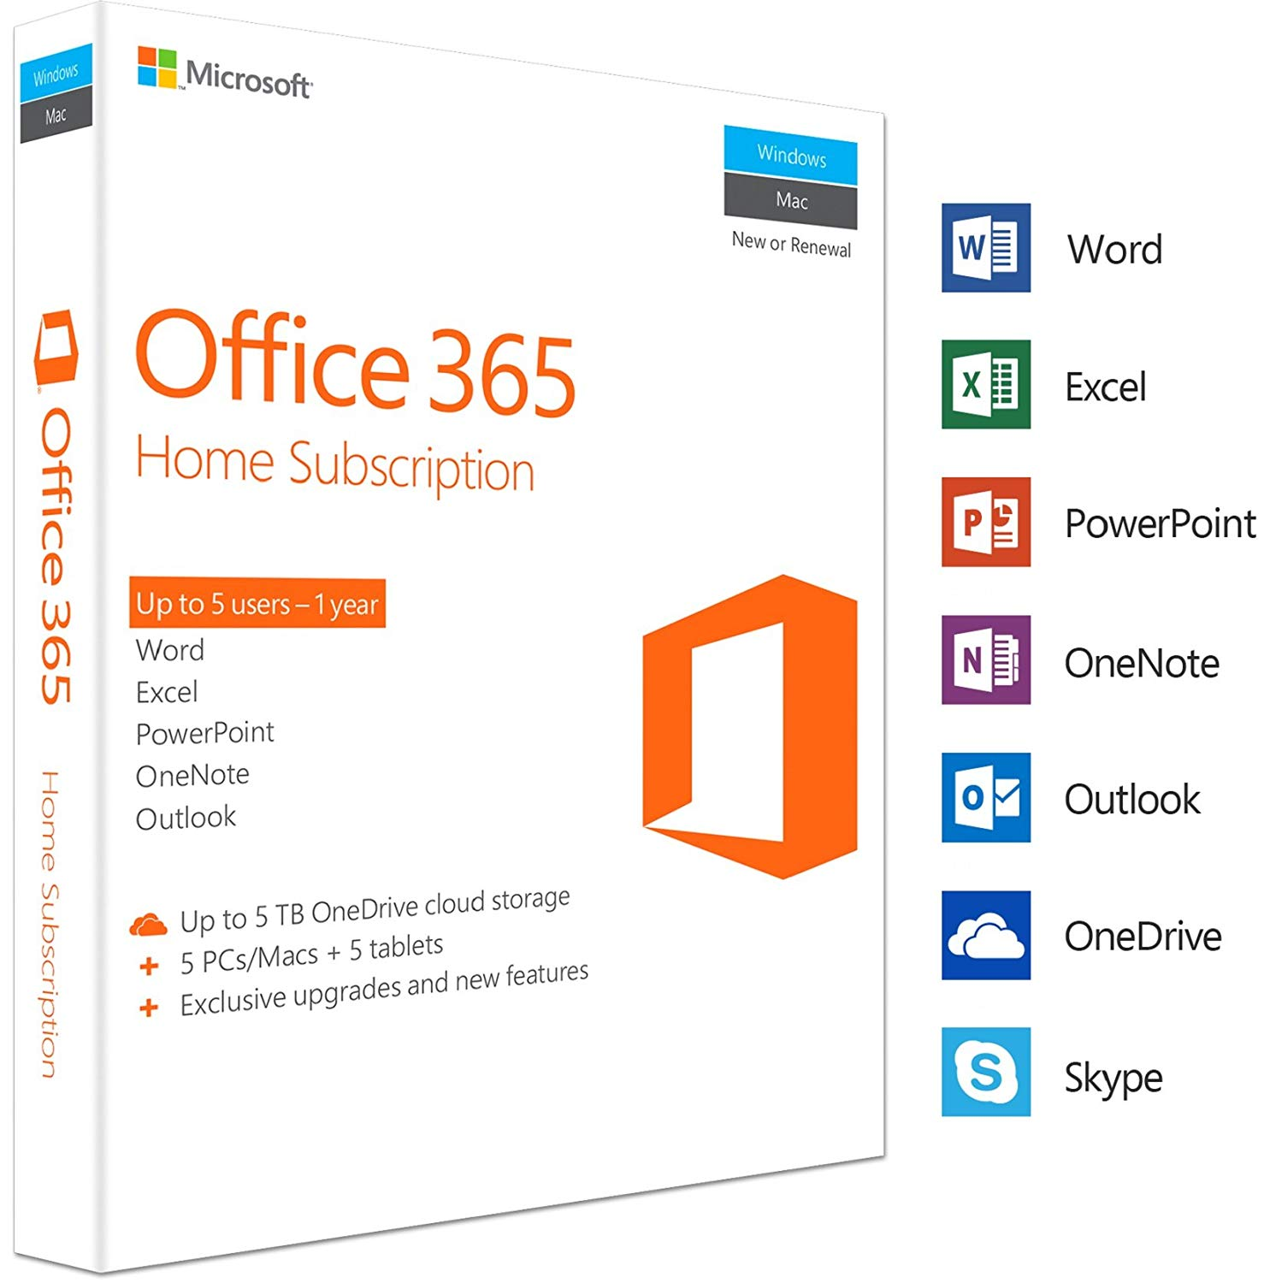
Office 365
Collaborate & share in real time
Cloud Storage
Portable
Tech support
Automatic backups
Premium security
Stay connected to your devices through Office 365 cloud services.

Slide 9
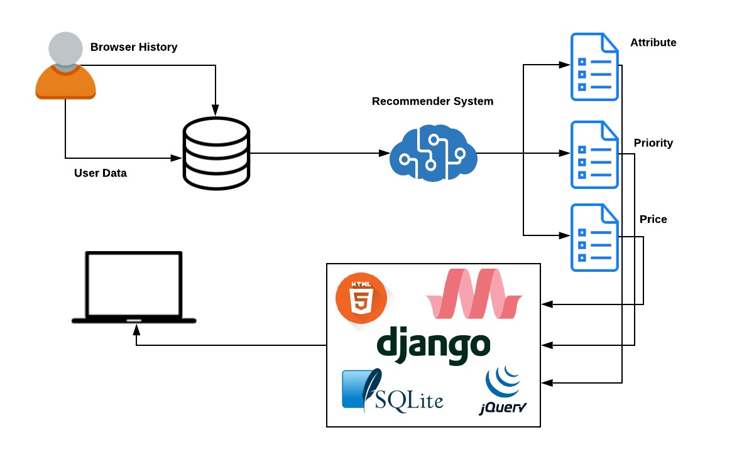
Architectural Diagram

Slide 10
Other possibilities/ Additional Implementations
Social Media
Twitter feed
LinkedIn Profile
Instagram, Facebook etc
Device diagnosis
Out of storage
CPU data
Battery health
Software issues

Slide 11
THANK YOU
ANY QUESTIONS?

